Slide 1
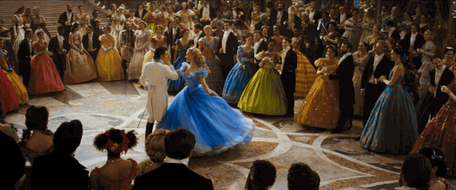
What do you want to wear to the party?

Slide 2
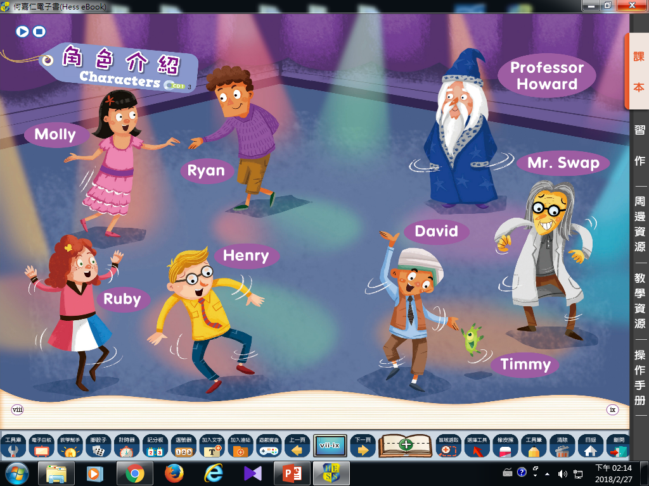

Slide 3
Look and guess.
Listen and write.
Check the answers.

Slide 4
Answers of Listening Practice
5. Mr. Swap
6. Ruby
7. David /
Timmy
8. Henry
1. Molly
2. Timmy
3. Professor Howard
4. Ryan

Slide 5
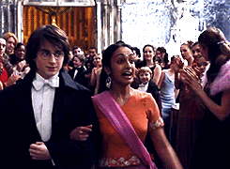
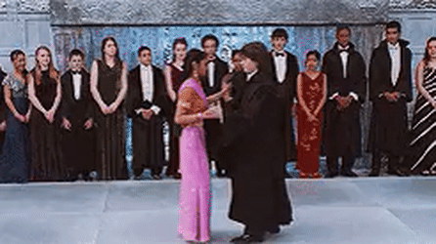
Harry Potter And The Goblet Of Fire
Opening ball scene

Slide 6
Something’s fun about promenade
舞會王/后 prom king/prom queen
慈善舞會 charity dance
生日舞會 birthday dancing ball
化妝舞會 masquerade
盛大舞會 grand ball
返校日舞會 home coming prom
舞廳 ballroom

Slide 7
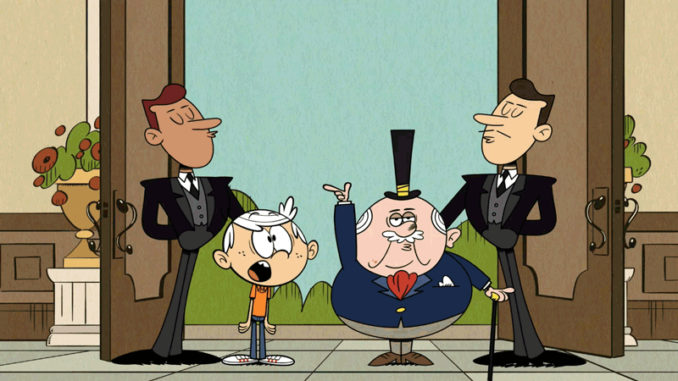
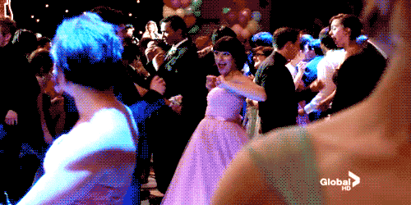

Slide 8
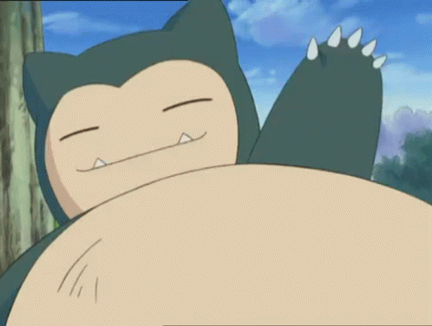
【本週英語作業】
聽:英語CD1第4~10首。
說:RT劇本練習。
寫:課本P7單字，每個10遍。
發下作業本

Slide 9
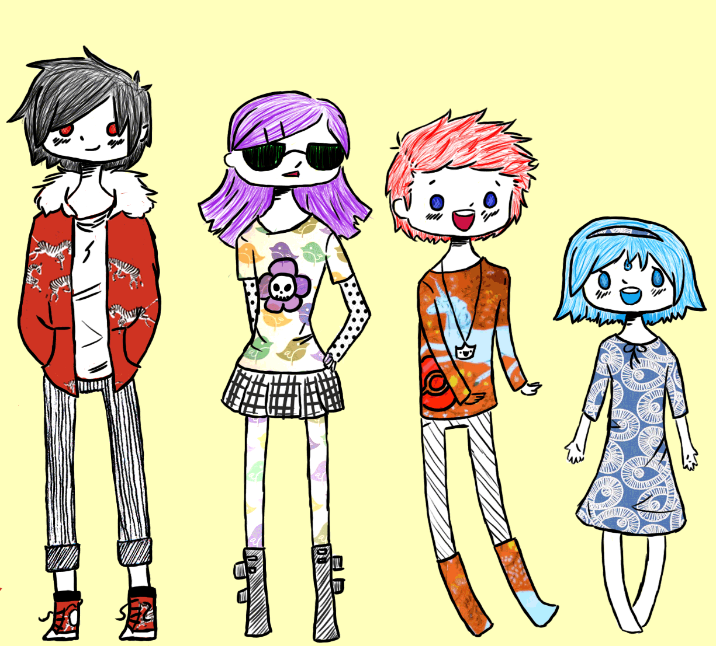
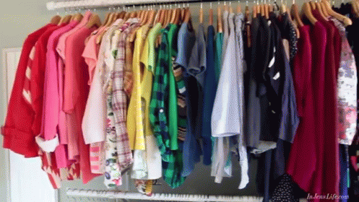
What do you want to wear?

Slide 10
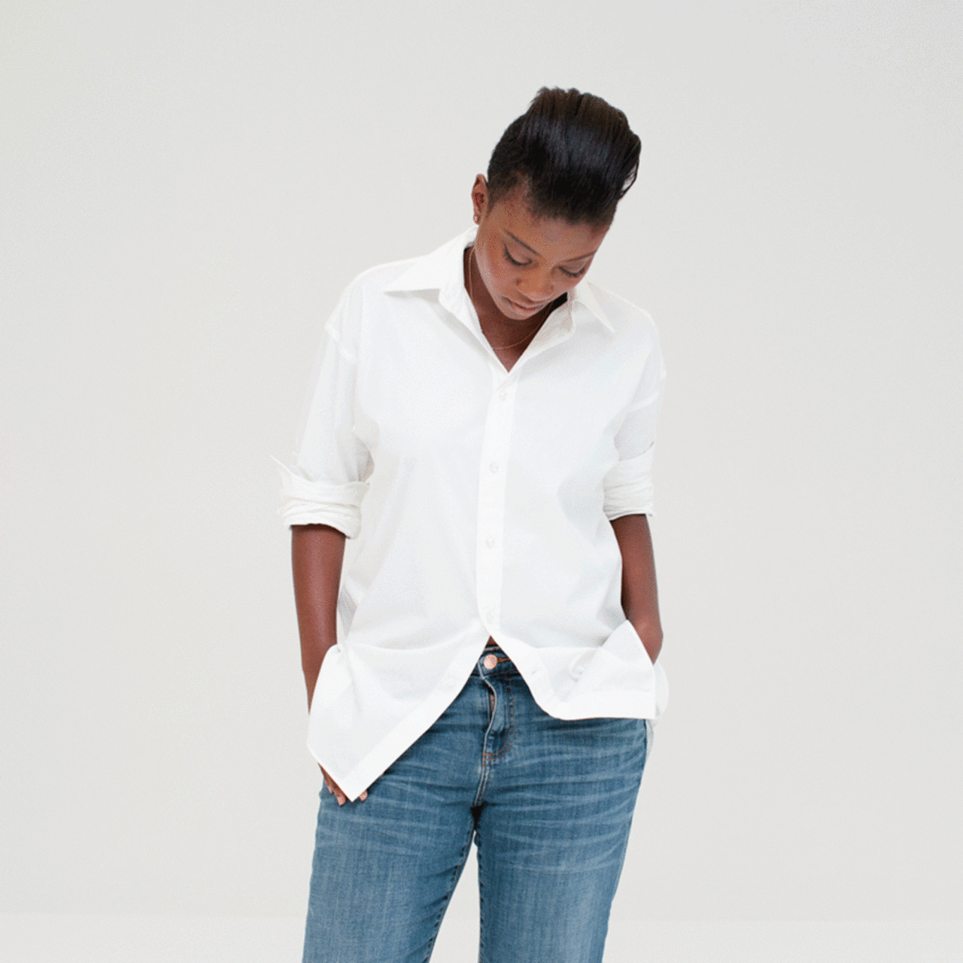
shirt

Slide 11
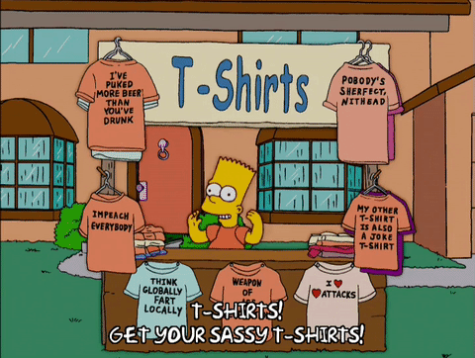
T- shirt

Slide 12
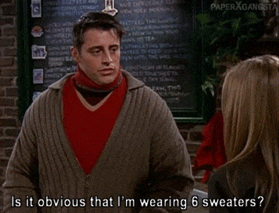
sweater

Slide 13
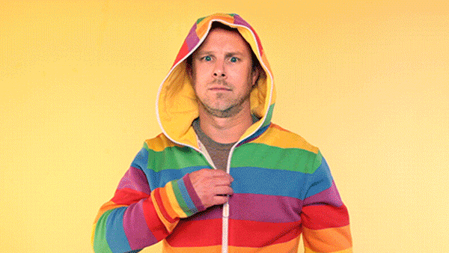
jacket

Slide 14
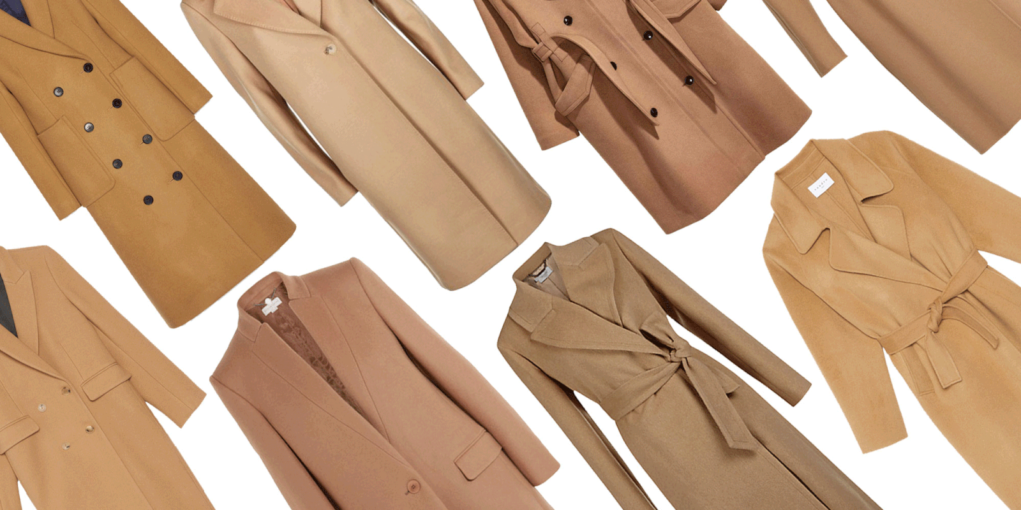
coat

Slide 15
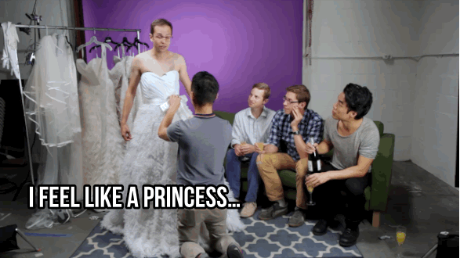
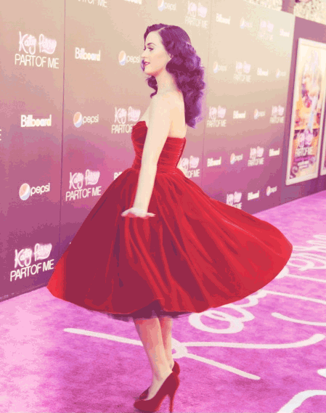
dress

Slide 16
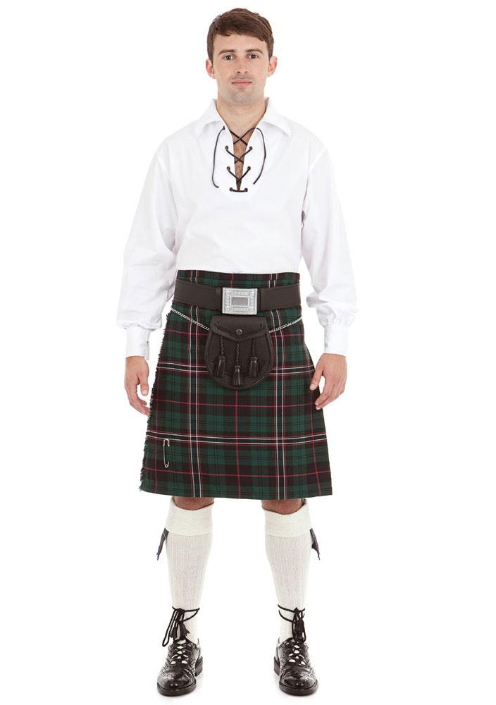
skirt

Slide 17
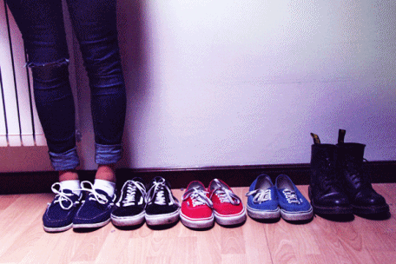
shoes

Slide 18
a pair of shoes
many pairs of shoes

Slide 19
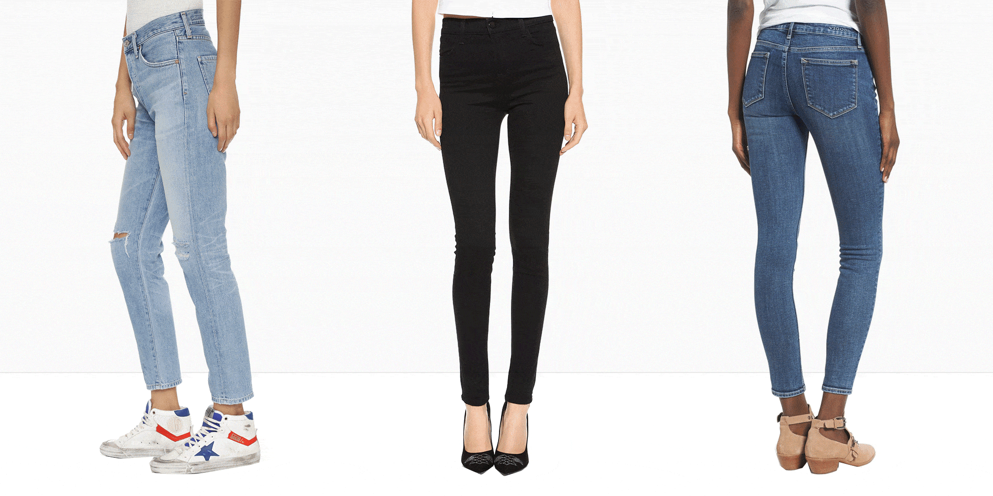
jeans

Slide 20
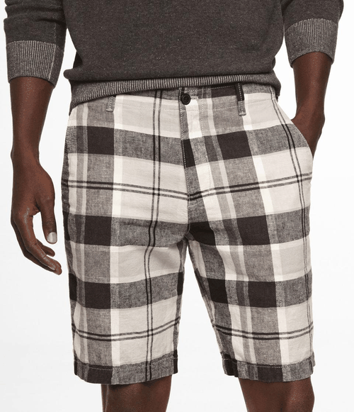
pants

Slide 21
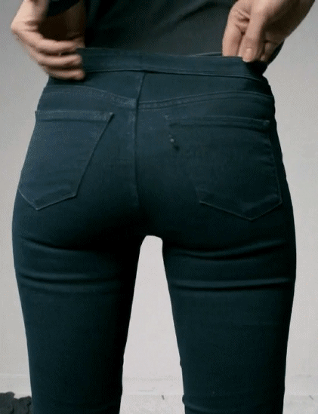
1
2
3
4
shirt
sweater
jacket
dress
6
8
5
7
skirt
shoes
jeans
pants

